Slide 1
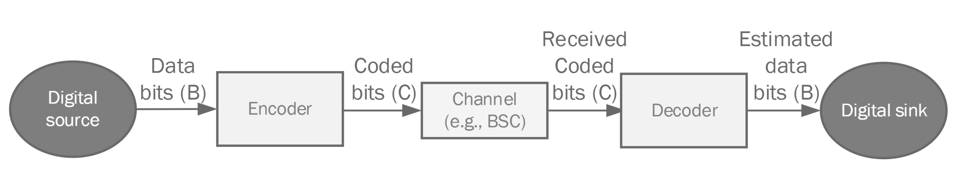

Part 3: Comparisons of coding techniques

Slide 2
In this project, we investigate the error correcting performance of different codes across a Binary Symmetric Channel (BSC) with a transition probability 0 ≤ 𝑝 ≤ 0.5. to assess the performance of these codes for different values of 𝑝
Repetation code – convolution code – polar codes

Slide 3
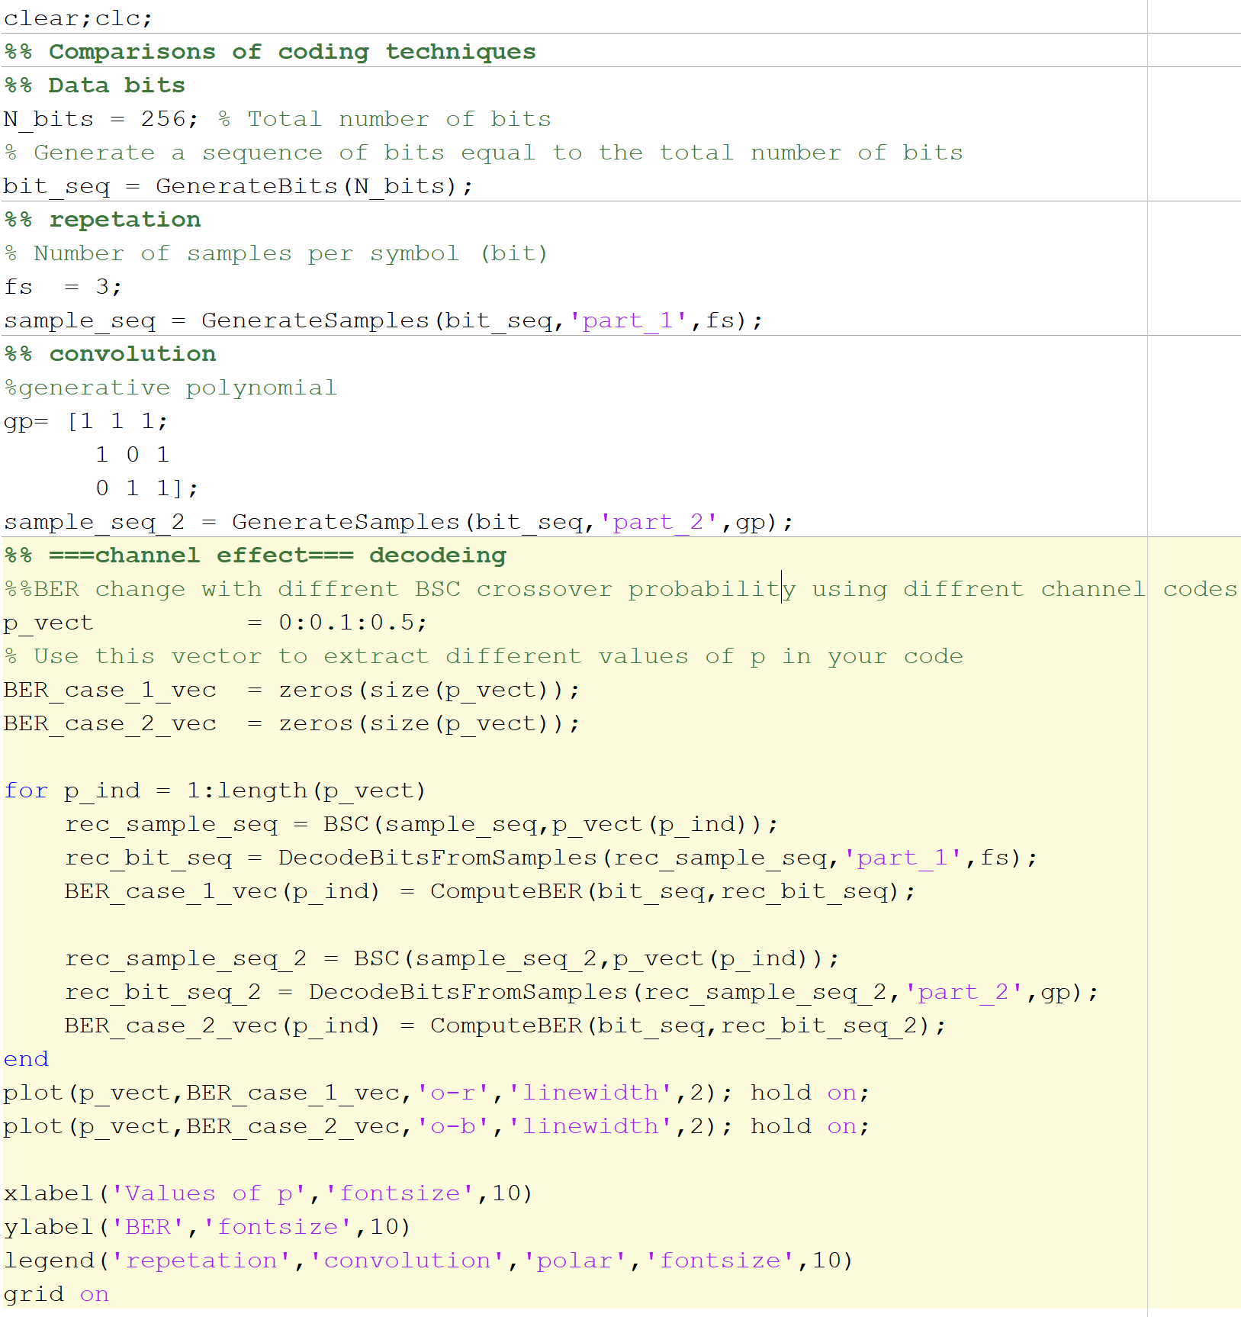
Main script all the decoders n encoders will be illustrated in it’s part here is the general structure

Slide 4
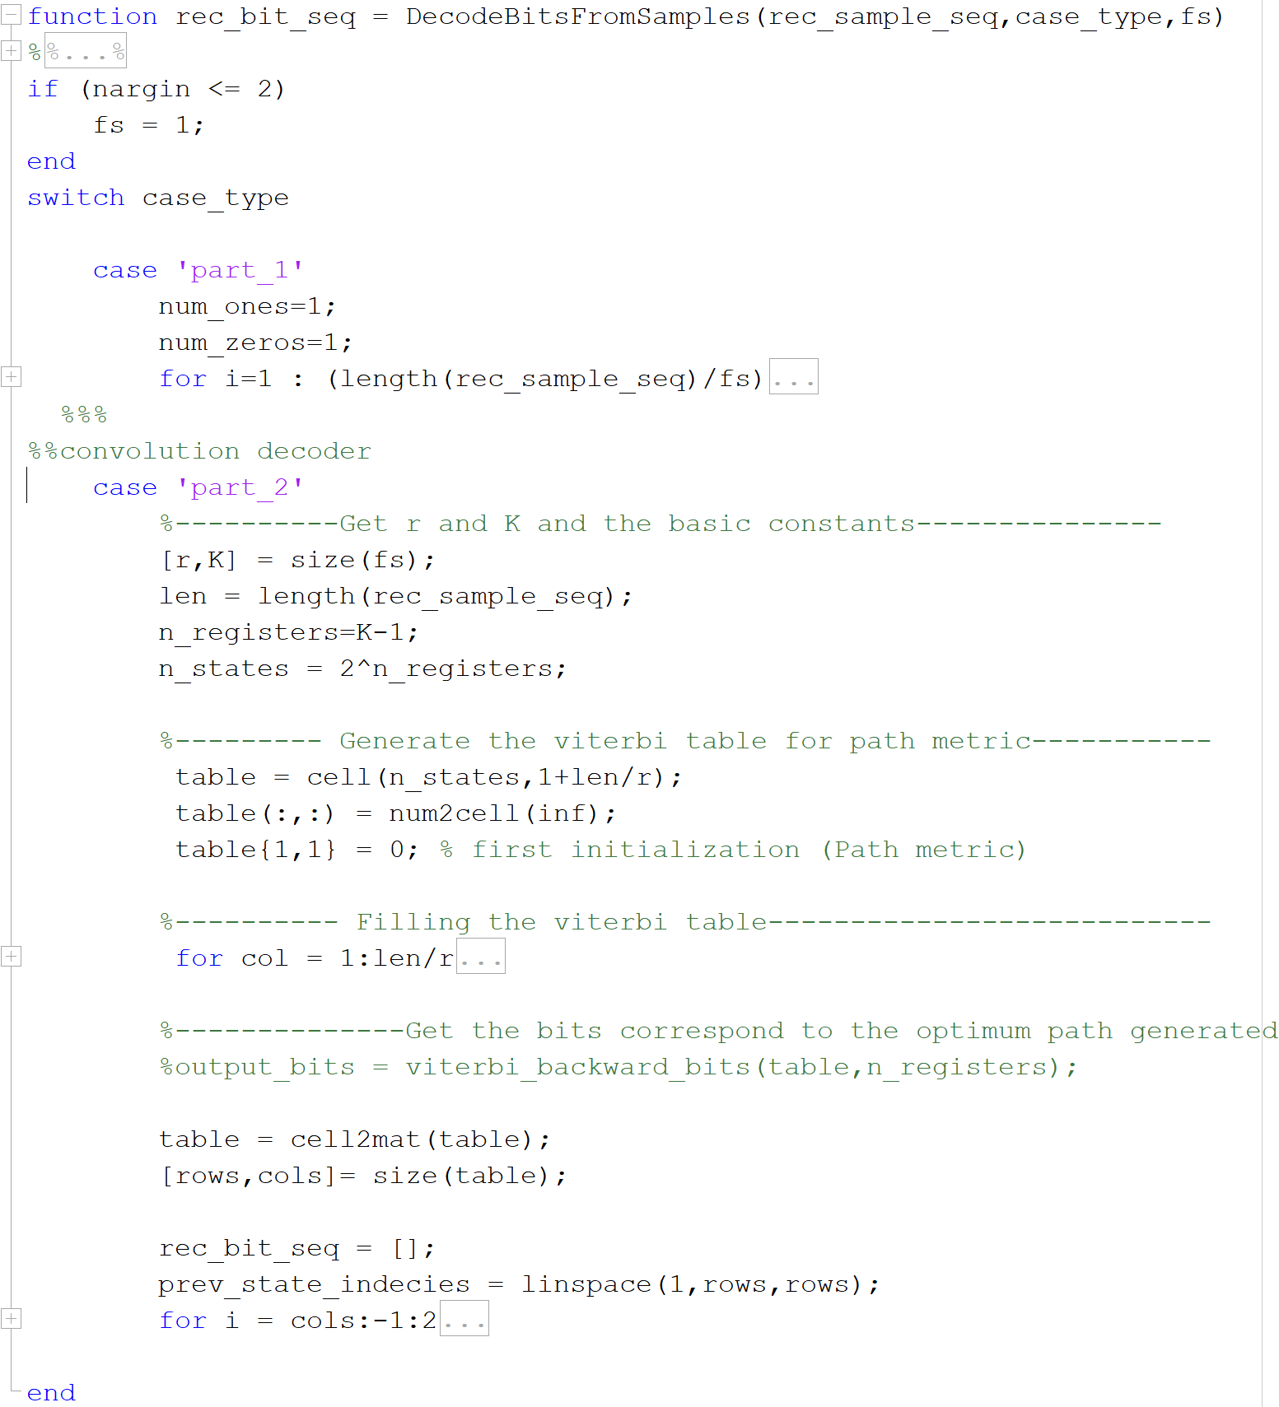
All Decoders are implemented inside this script

Slide 5
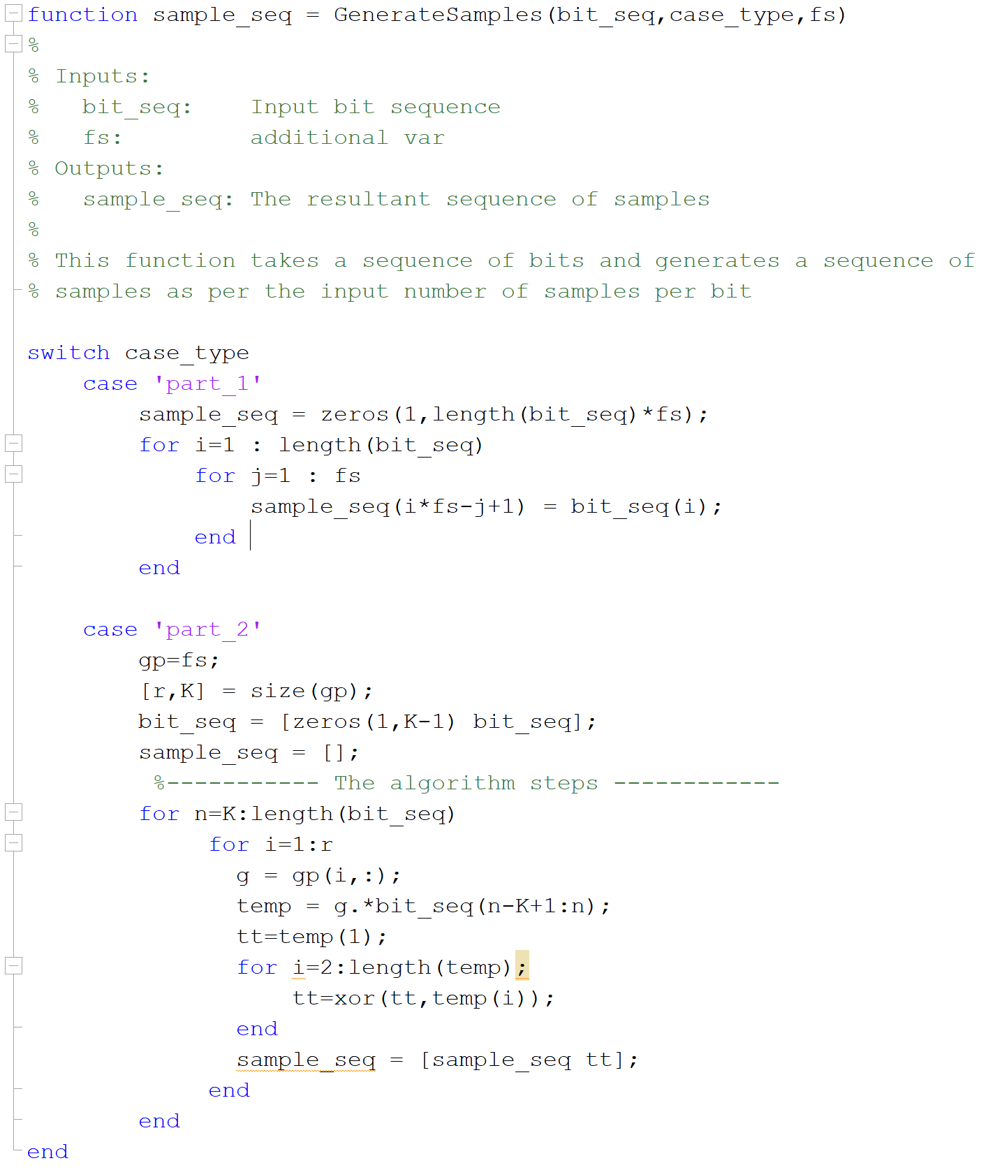
All Decoders are implemented inside this script

Slide 6
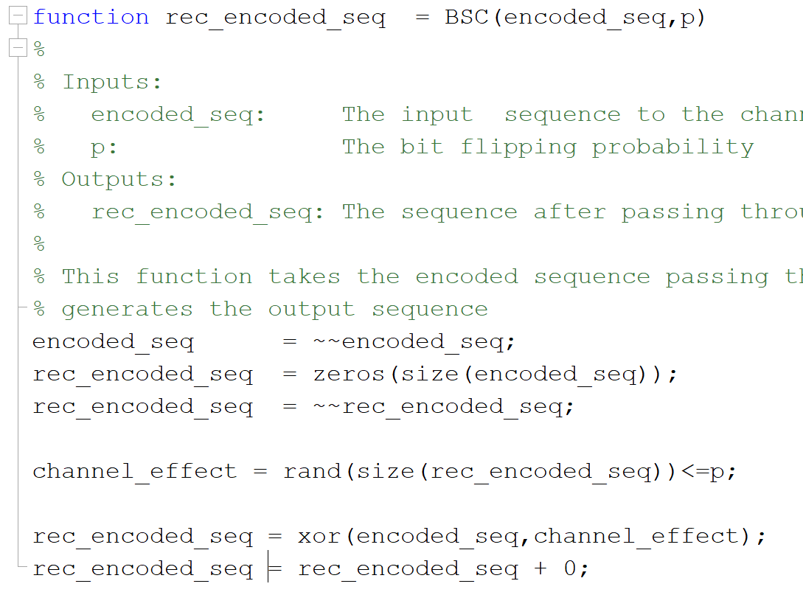
BSC

Slide 7
Repetation code
In coding theory, the repetition code is one of the most basic error-correcting codes. In order to transmIn coding theory, the repetition code is one of the most basic error-correcting codes. In order to transmit a message over a noisy channel that may corrupt the transmission in a few places, the idea of the repetition code is to just repeat the message several times. The hope is that the channel corrupts only a minority of these repetitionsit a message over a noisy channel that may corrupt the transmission in a few places, the idea of the repetition code is to just repeat the message several times. The hope is that the channel corrupts only a minority of these repetitions
The chief attraction of the repetition code is the ease of implementation.
the minimum Hamming distance of the code equals its length . This gives the repetition code an error correcting capacity of errors in any code word)
. If the length of a binary repetition code is odd, then it's a perfect code.

Slide 8
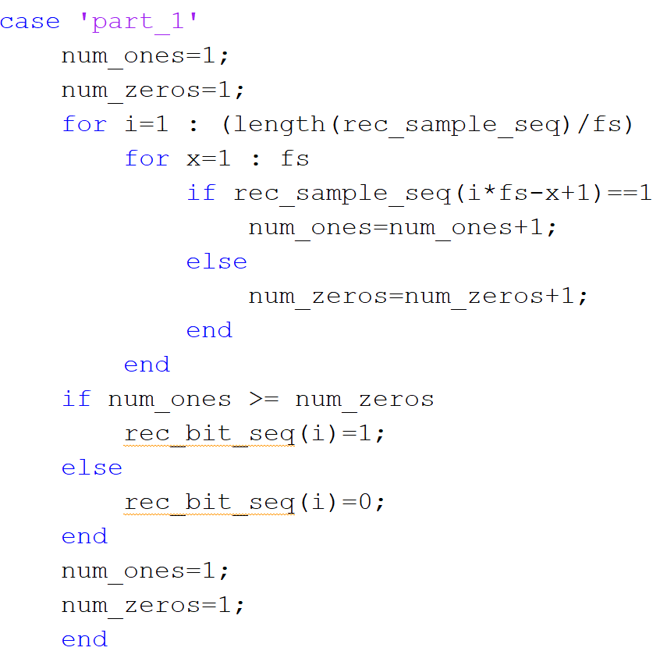
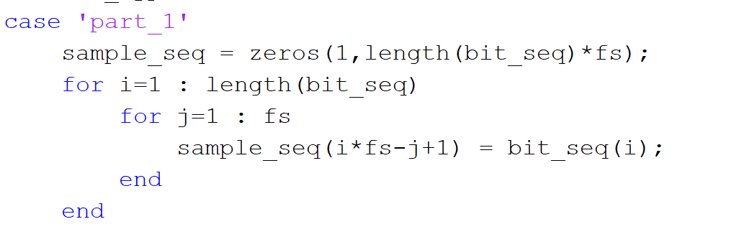
Here is a simulation for using repetation code for the transmitted data using matlab
Encoder
Very simple all about repeting every bit with L times as L=1/r :r→rate
Decoder
Counts the L bits for each bit and decides upon than either it’s 0 or 1

Slide 9
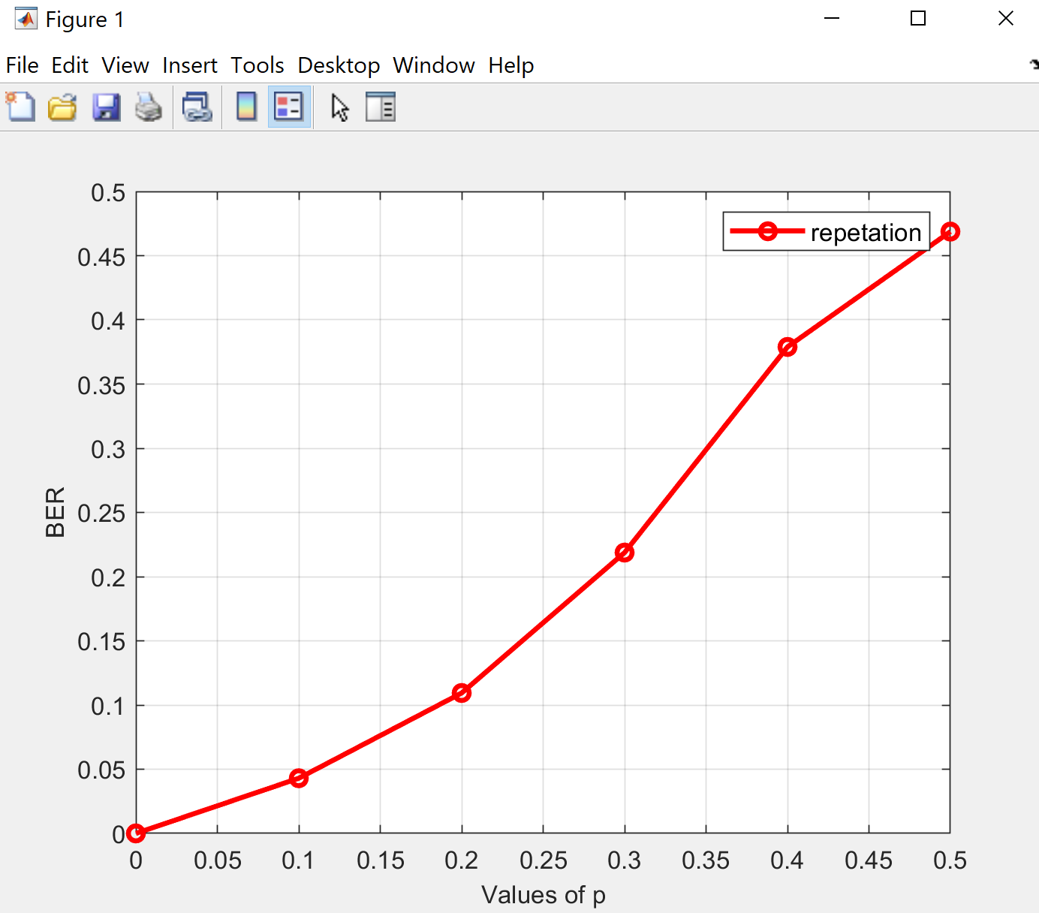
BER with p

Slide 10
convolution code
is a type of error-correcting code that generates parity symbols via the sliding application of a boolean polynomial function to a data stream. The sliding application represents the 'convolution' of the encoder over the data, which gives rise to the term 'convolutional coding'. The sliding nature of the convolutional codes facilitates trellis decoding using a time-invariant trellis. Time invariant trellis decoding allows convolutional codes to be maximum-likelihood soft-decision decoded with reasonable complexity

Slide 11

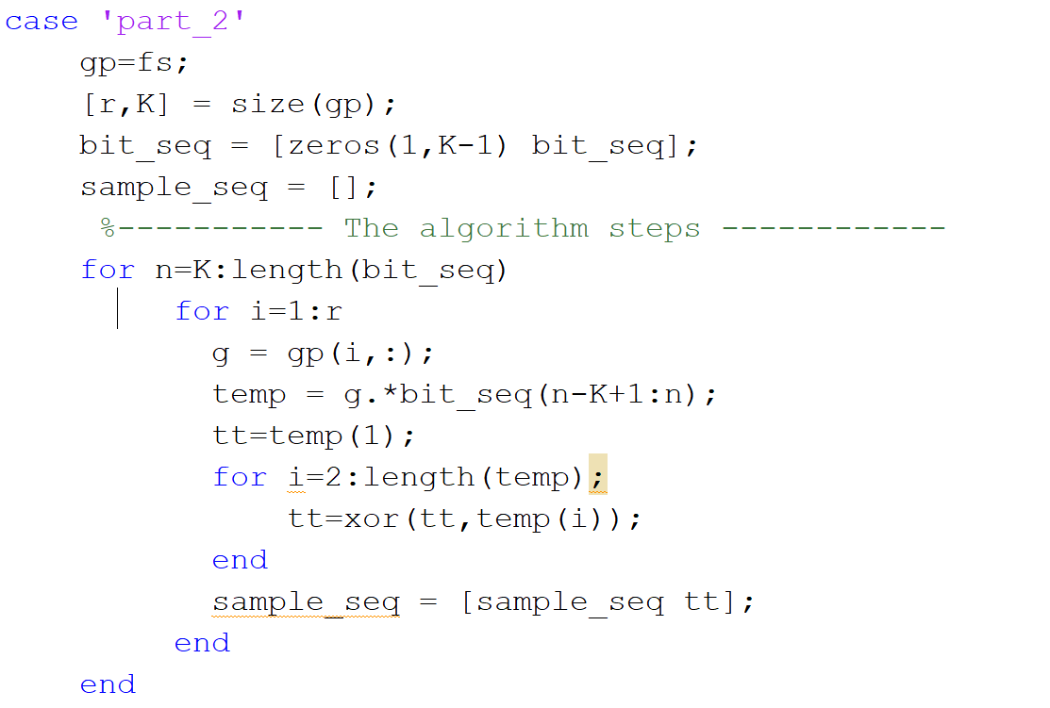
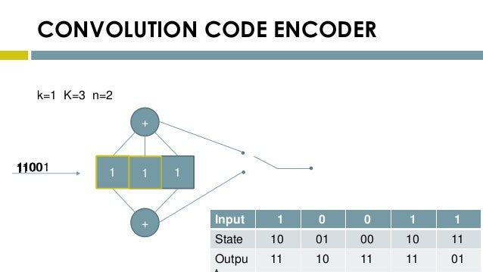
encoder

Slide 12
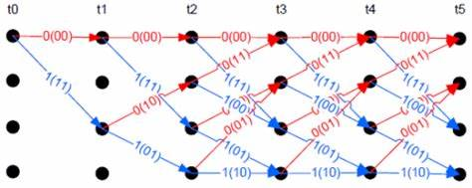
Decoding
A Viterbi decoder uses the Viterbi algorithm for decoding a bitstream that has been encoded using a convolutional code or trellis code.
There are other algorithms for decoding a convolutionally encoded stream (for example, the Fano algorithm). The Viterbi algorithm is the most resource-consuming, but it does the maximum likelihood decoding. It is most often used for decoding convolutional codes with constraint lengths k≤3, but values up to k=15 are used in practice.

Slide 13
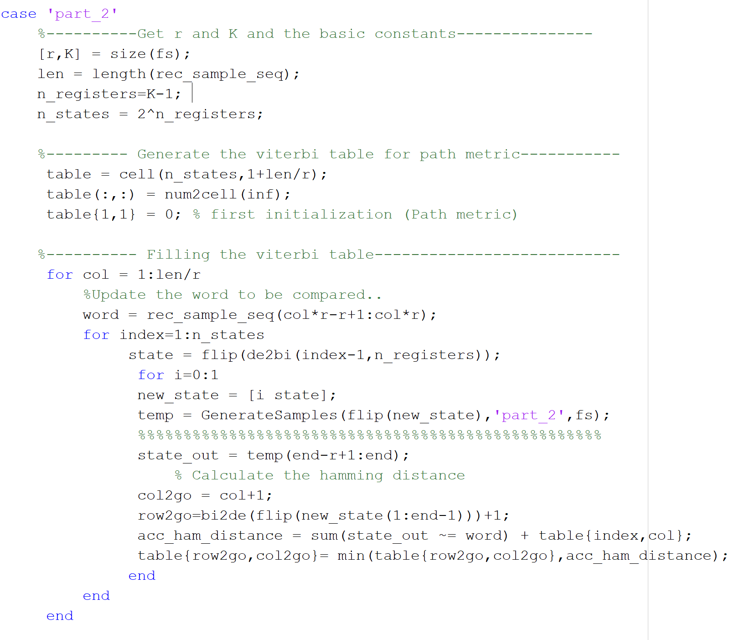
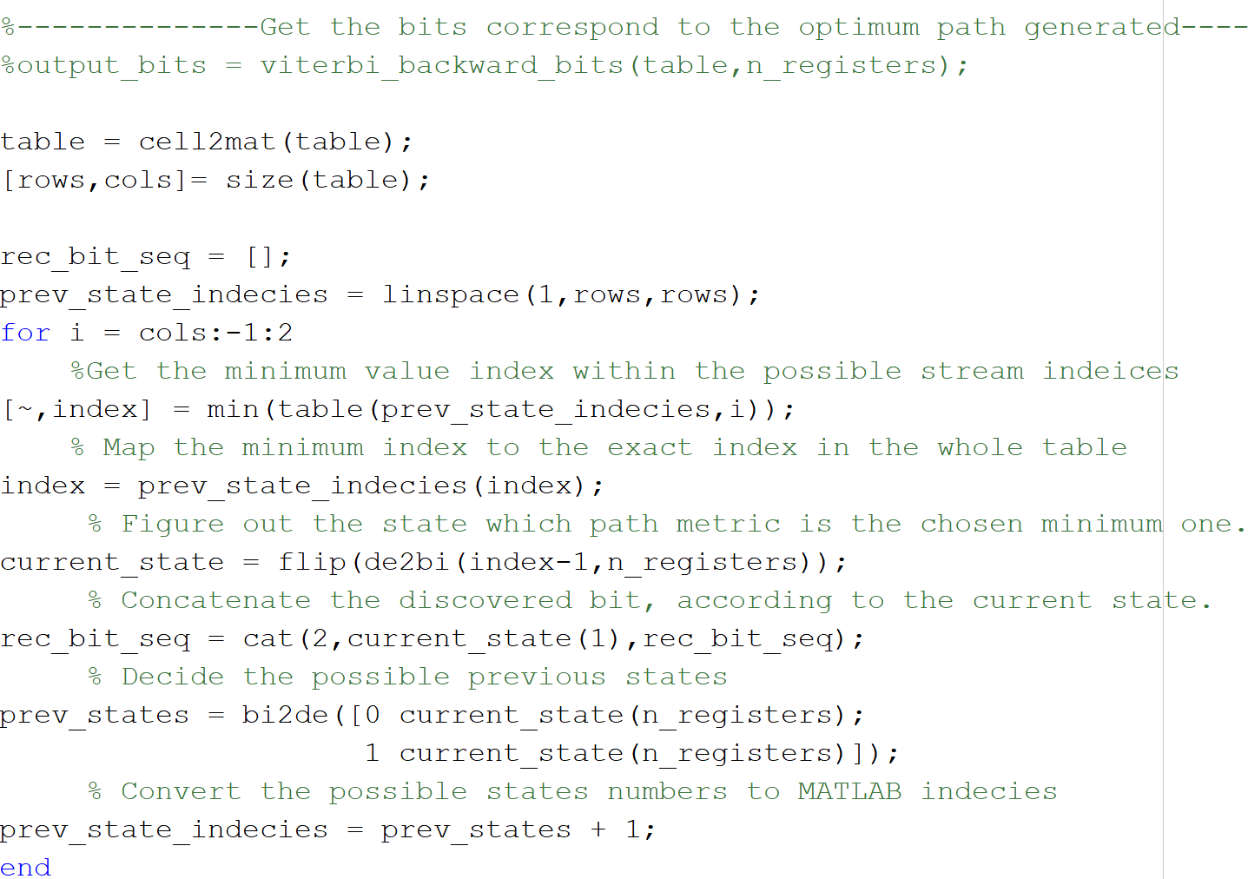
decoder

Slide 14
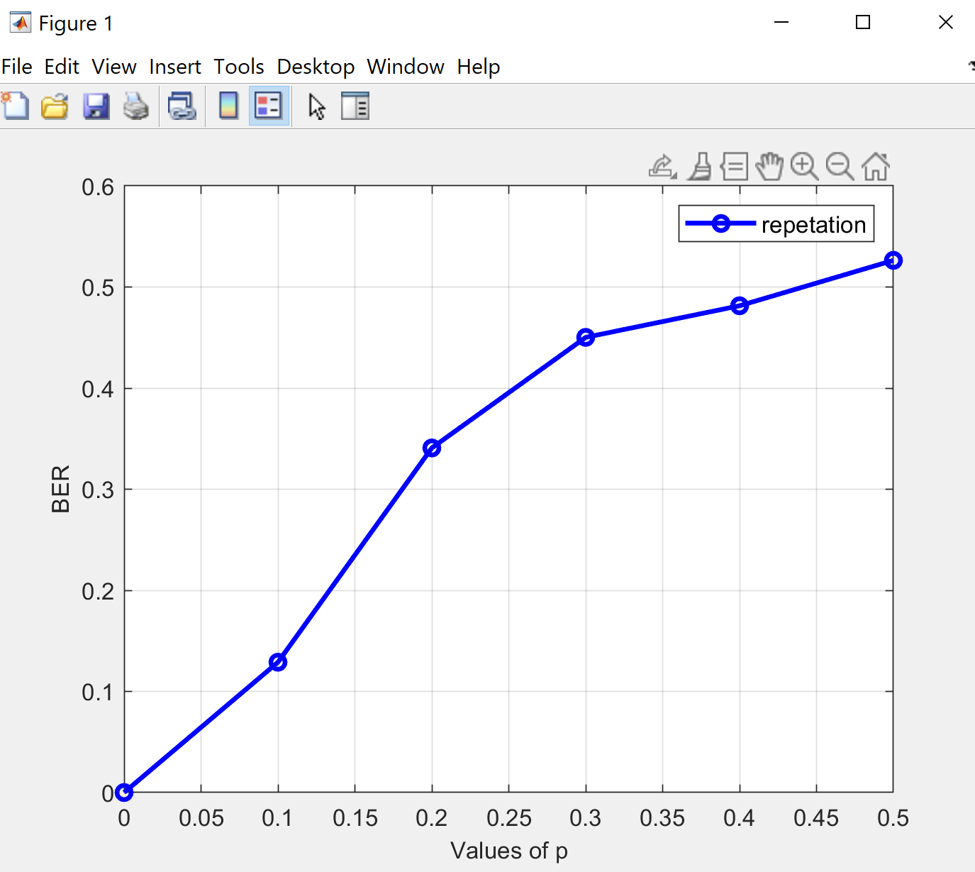
BER with P

Slide 15
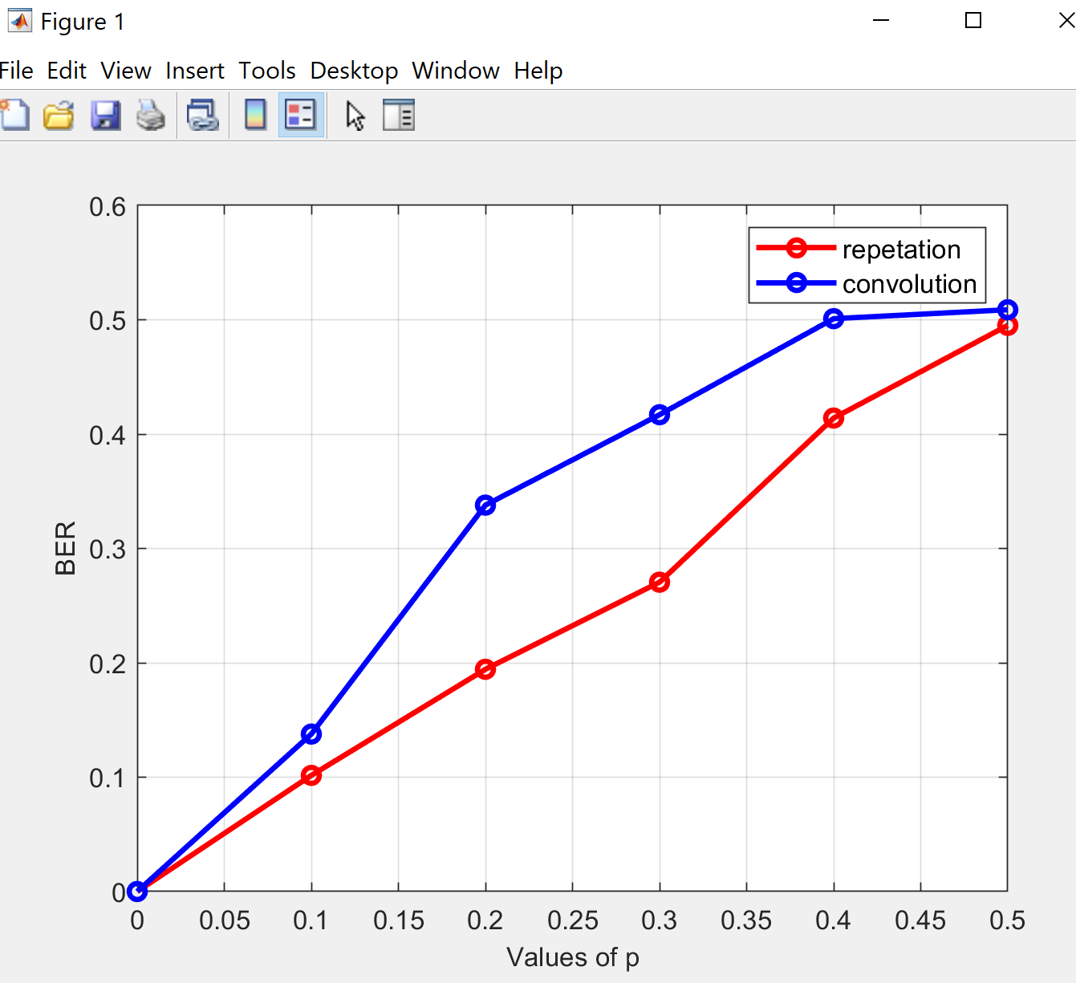
BER with P repetation -convolution

Slide 16
POLAR Codes

